Slide 1
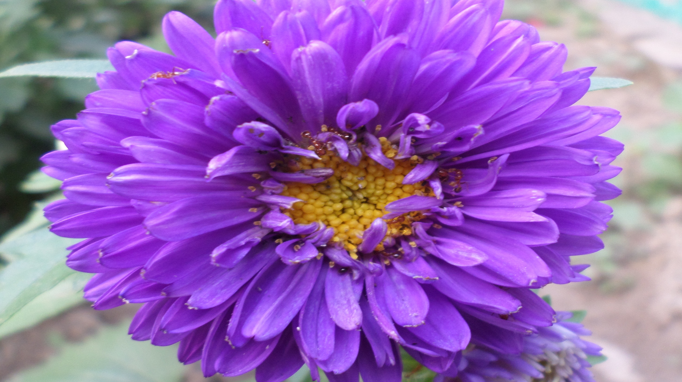
Welcome
STUDENTS

Slide 2
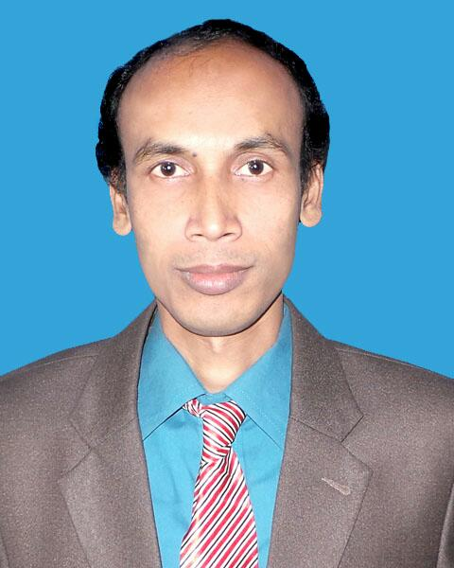
Presented by-
MD. ASHEQ REZA
ASSISTENT TEACHER

Slide 3
Introducing lesson:
Class: Five
Subject: English
Unit: 10 (My home district.)
Lessons: (1-2)
Part of the lesson: My home --------- - --I love my home district !
Time: 45 minutes

Slide 4
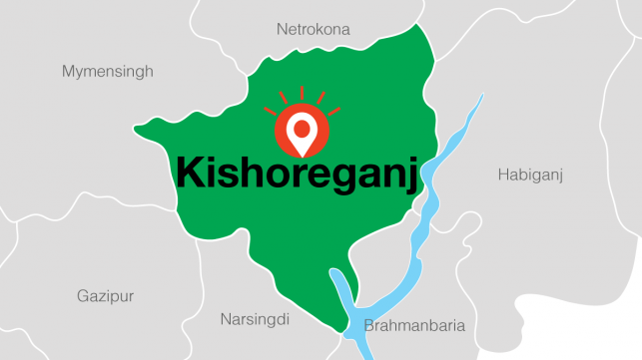

Slide 5
MY HOME DISTRICT
kishoregonj

Slide 6
Learning outcomes
By end of the lessons the students will be able to----
What is the name of your home district ?
2.How far is it from Dhaka?
Who is chandrabati?
4.who is upendro Kishore roy ?

Slide 7
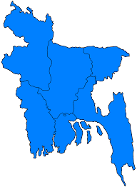
Look at the picture and think yourself and then discuss with your pair:
Kishoreganj
Dhaka

Slide 8
My home district is Kishoreganj. It is about 145 kilometres from Dhaka. The district has 8 municipalities , 13 upazilas ,108 unions and 1745 villages. Kishoreganj stand
On the fuleshwari river .

Slide 9
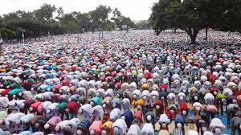
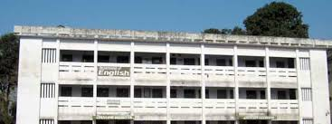
Kishoreganj is a small town , but there are many important places in and around it.The largest eid fairgrounds , called Solakia Eid Ground and the well-known Government Gurudayal College are in the town.

Slide 10
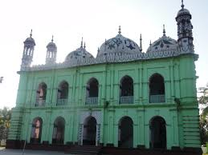
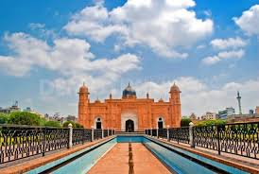
The Pagla Mosque is also in my home district . Outside the town , you can visit the Fort of Isah Khan at Jangal Bari.

Slide 11
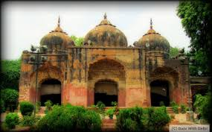
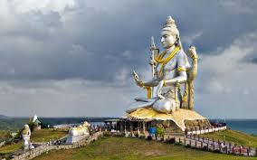
You can also see the Shah Mohammad Mosque at Egaroshindhur. Near the Fuleshwari River , you can see the Shiva Temple of Chandrabati .

Slide 12
The great painter Zainul Abedin comes from Kishoreganj , too. Syed Nazrul Islam , the first acting president of Bangladesh , is also from here. I love my home district !

Slide 13
Kishoreganj
Solakia eid ground
Gurudayal college
Pagla mosque
Fort of Isah Khan
Shah Muhammad mosque

Slide 14
New wodrs and meaning
Solakia -eid -ground - ‡mvjvwKqv C`Mvn& gq`vb
Gurudayal-college - ¸iæ `qvj K‡jR
Pagla-mosque - cvMjv gmwR`
Fort-of-Isah-Khan – Ckv Luvi `~M©
Fuleshwari-river - dz‡jk¦ix b`x
Chandrabati -
Literature – mvwnwZ¨K
Children - wkïiv
Famous. - weL¨vZ

Slide 15
Group work
Group –A:
Make list of the important places in Kishoreganj
Group-B:
Write the short answer:
Which place do you think is the most interesting in Kishoreganj ? Why ?
Where was Zainul Abedin bron ?
2.Who was Syed Nazrul Islam?
3. Who was a famous painter ?

Slide 16
Evaluation:
Answer the questions in short:
A) What’s the name of Mamun’s home district ?
B) How far is it from Dhaka ?
C) How did it get its name ?
d) who was Zainul Abedin?

Slide 17
Homework
You will write five sentences about your own district.

Slide 18
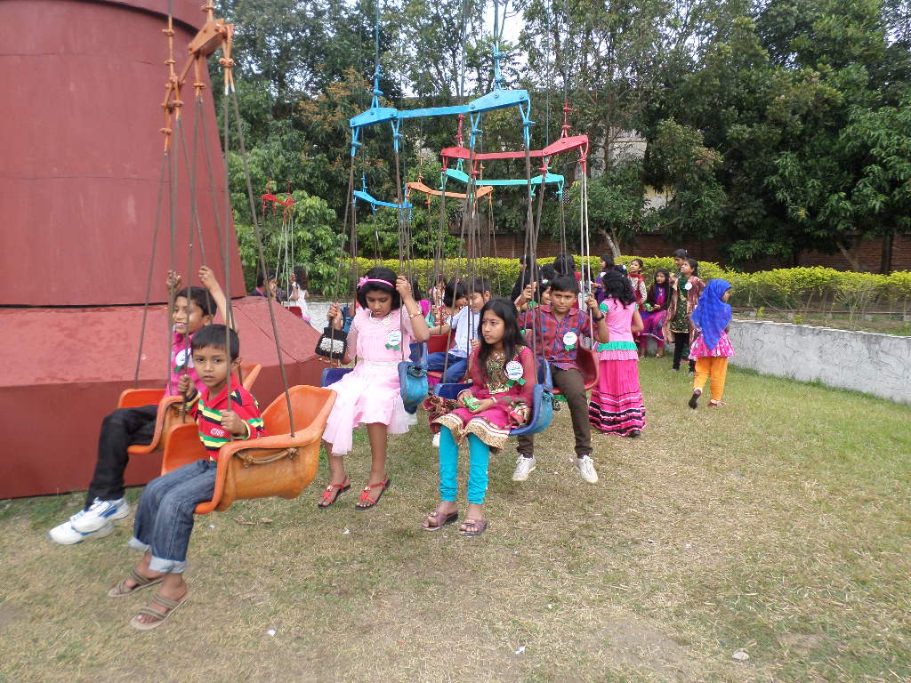
Thank you everybody for your active participation.

